Slide 1
the STATUS OF COOPERATIVE FINANCIAL INSTITUTIONS (CFIs) INTERNATIONALLY
Some Data and reflections for the INDABA
Juan Buchenau
March 18, 2021

Slide 2
Content guide
CFIs globally and in Africa - a quick overview
Challenges faced by CFIs
Adapting to the new environment, the way forward

Slide 3
CFIs globally and in Africa - a quick overview

Slide 4
Financial cooperative sectors worldwide
They are very relevant: 704 million members (about 9% of the world adult population) served by over 200,000 entities (census 2014 by Dave Grace)
Globally, CFIs are growing strong – according to WOCCU, CFIs showed between 2005 to 2019
  An average growth in members of 7.7% per annum
  An average growth in assets of 11.0% per annum
Across countries, financial coop sectors are very diverse:
  From countries with tens of thousands of small entities like in Ethiopia or Indonesia
  To countries with few very large entities of the size of banks
  And countries with a mix of large and small entities

Slide 5
Financial cooperatives in Africa
In Africa According to WOCCU 2019), CFIs:
  Serve around 13% of the adult population
  Are much smaller than banks with average assets of USD 300,000 per CFI and each serving slightly less than 1,000 members
  Are growing fast with an estimated yearly growth of membership between 2015 and 2019 of around 24%

Slide 6
Challenges faced by CFIs

Slide 7
CFIs face today significant challenges (I)
Increased competitive pressure due to technological innovations:
  Banks move down-market and start serving their members
  Fintech players such as mobile operators offer new services
Increased regulatory pressure:
  CFI sectors get more attention from regulators and supervisors as they grow and become more important
  This leads to stricter regulations and oversight, more sophisticated reporting requirements

Slide 8
CFIs face today significant challenges (II)
Members and potential members become more demanding / sophisticated in time and there is a growing interest in digital financial services:
  Population becoming more educated, more urban, and younger
… while CFI membership in many places getting older and remaining more rural
COVID has in addition affected livelihoods and income of CFI members and of the CFIs themselves

Slide 9
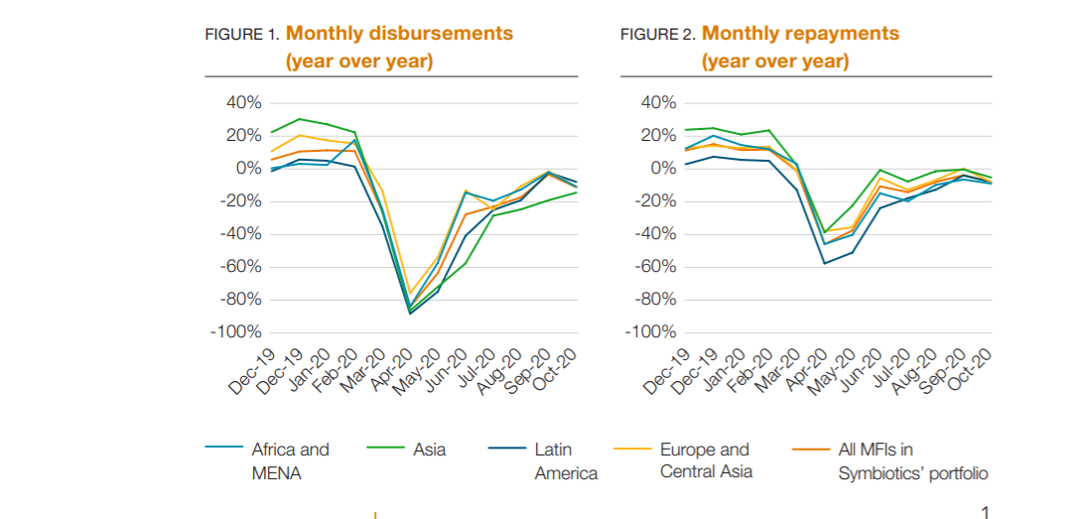
COVID: Disbursements and repayments of MFIs and CFIs took a hit, but are now slowly recovering
Source: CGAP , Symbiotics: MFIs during the crisis
https://www.cgap.org/sites/default/files/datasets/2-2021-COVID-Briefing-Snapshot-MFIs-During-the-Crisis.pdf

Slide 10
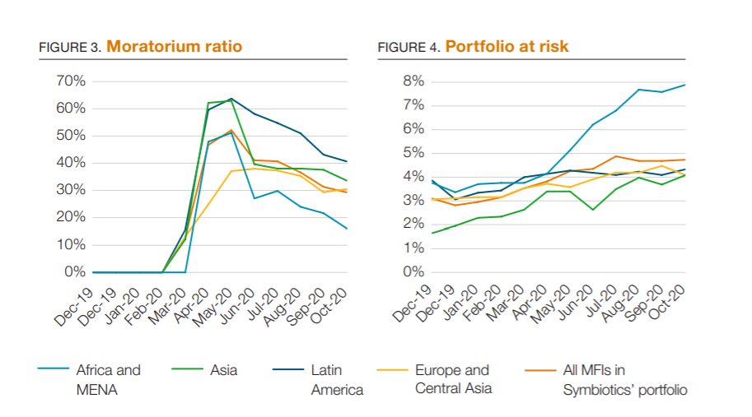
…leading globally to a massive rescheduling of loans and to a deterioration of the loan portfolio quality
Source: CGAP , Symbiotics: MFIs during the crisis
https://www.cgap.org/sites/default/files/datasets/2-2021-COVID-Briefing-Snapshot-MFIs-During-the-Crisis.pdf

Slide 11
Adapting to the new environment

Slide 12
How are CFIs adapting? What is the way forward?
Increased use of technology
Deposit insurance
→ Need for investments + increased costs
Options

Slide 13
CFIs are looking at options to increase their use of technology in order to diversify services and reduce costs, learning that:
Technology is expensive and in a fast process of change
It is more efficient to acquire services from third parties than to produce it “in house”
CFI decision makers require training and professional guidance to be able to make necessary decisions

Slide 14
In addition, CFIs are also introducing deposit Insurance in many countries considering that it…
Is useful to safeguard the operations of the CFIs and the safety of deposits
Needs to be well designed to generate trust:
  Minimum equity to deal with entities in distress
  Excellent coordination with supervisor
…and… that they impose on CFIs the cost of insurance as well as higher standards of financial and operational performance before being covered

Slide 15
All this requires substantial investments and increased expenditures for CFIs to
  Have more professional boards and management
  Pay for the higher costs of compliance and ensure the functioning of adequate controls
  Pay for deposit insurance
  Pay for the required software and hardware

Slide 16
To deal with these challenges and to defray higher costs, CFIs worldwide pursue different strategies:
They integrate into apex organizations that can provide shared services
They consolidate through mergers to achieve economies of scale
They outsource some functions to external (private) service providers
-> In different countries, different solutions (or combination of solutions) are being implemented

Slide 17
International experience shows that successful CFIs and CFI sectors are those that make up their mind, discuss and find consensus around a model and define a path to achieve their common objectives

